Slide 1
Presentation slide template
Thank you for taking part in the
PASS Data Community Summit 2022.
Any questions?
Please email Annabel.Bradford@red-gate.com

Slide 2
Contents Everything you need for your presentation
3 - Slide templates
7 - Icons and graphics for you to use
11 - Virtual backgrounds (optional)
14 - Slide examples

Slide 3
Slide templates Including essential slides and personalizing your title slide with icons

Slide 4
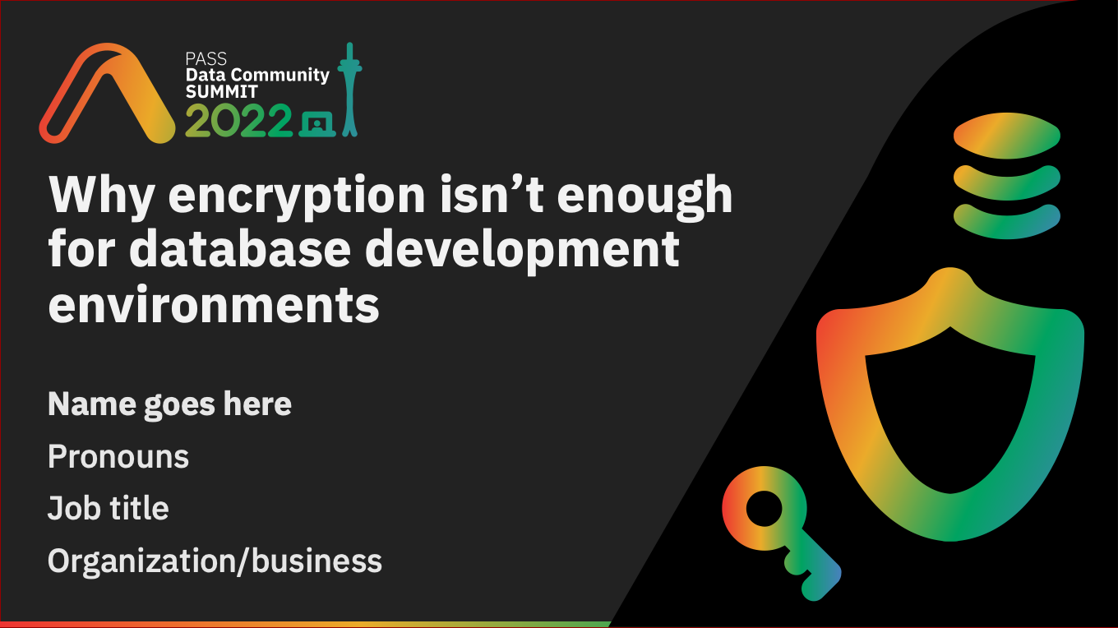
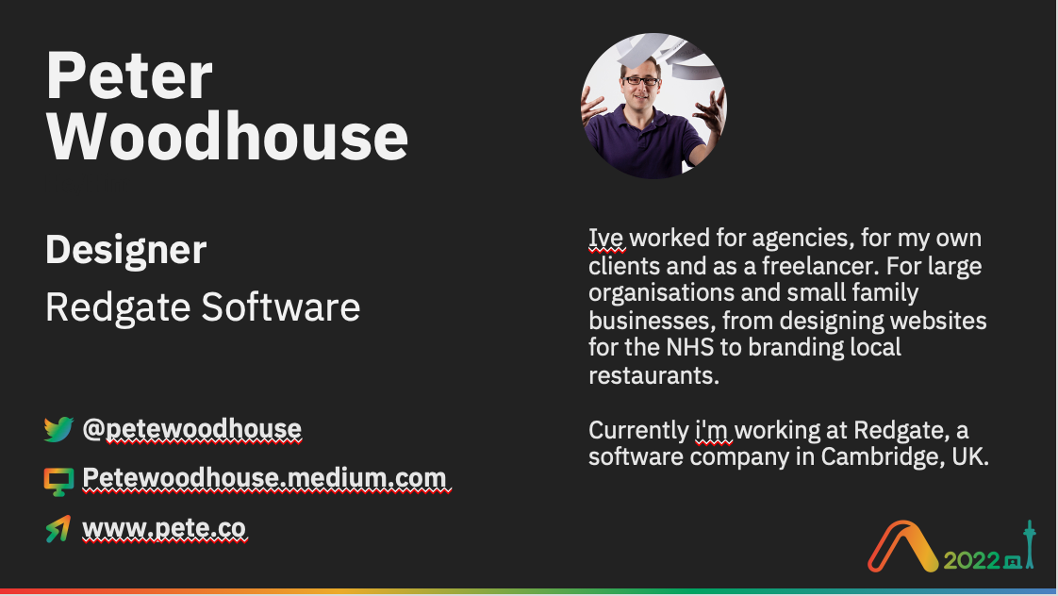

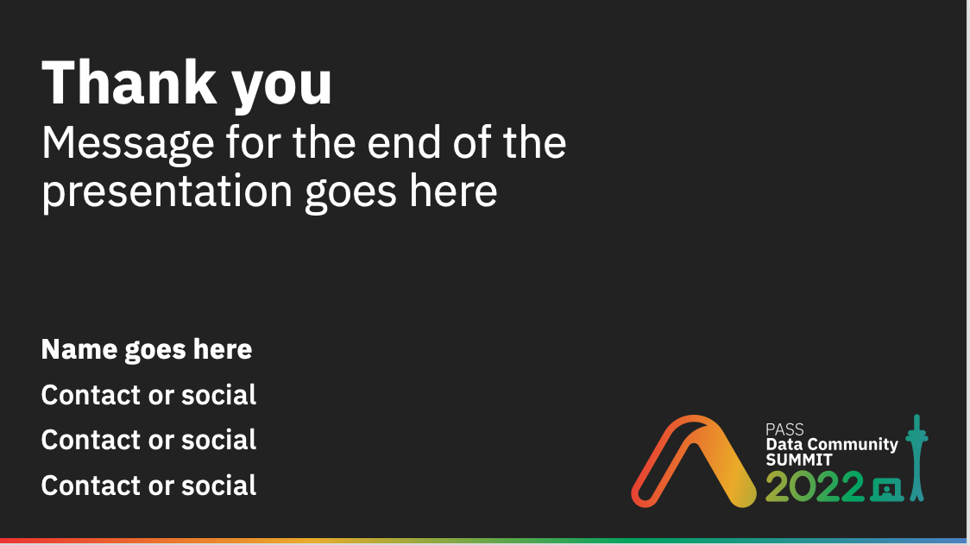
Slide templates Essential slides you must include in your presentation
Title slide
Speaker slide
Evaluation slide
Thank you slide

Slide 5
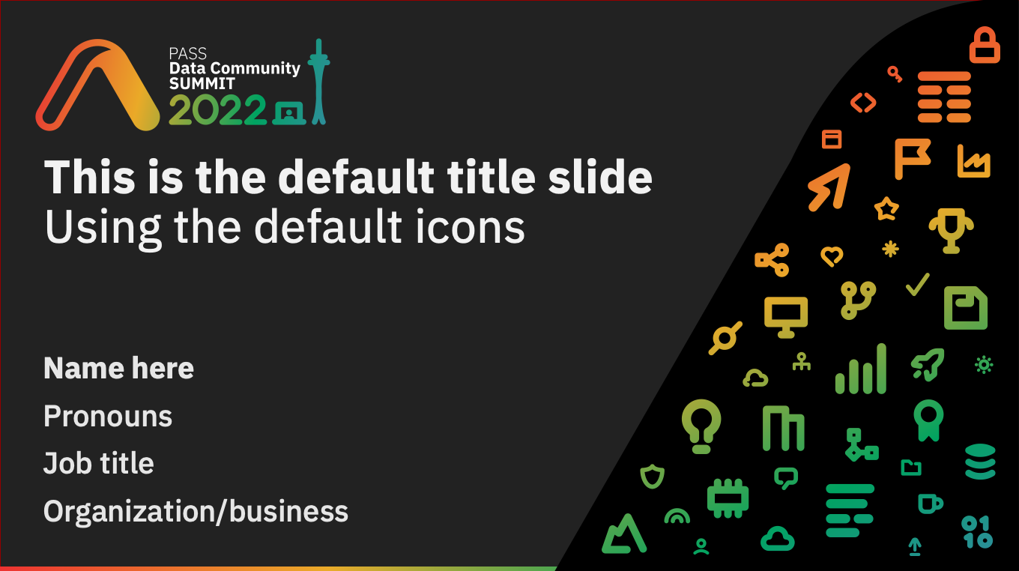
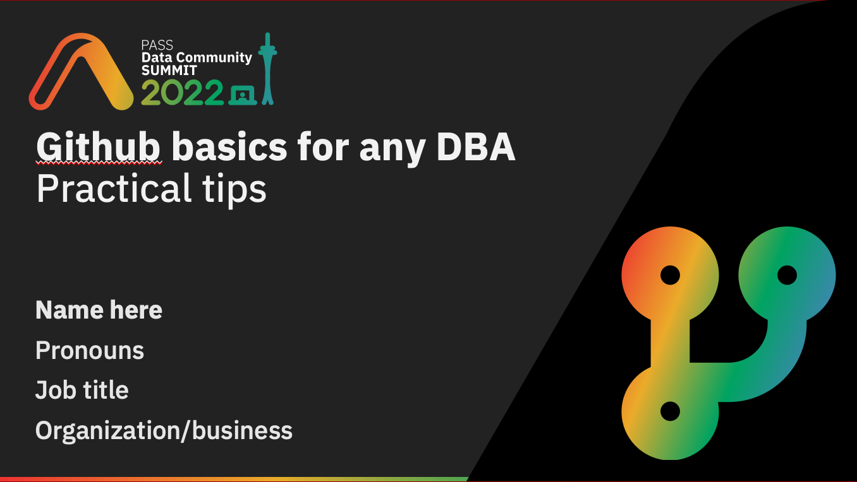
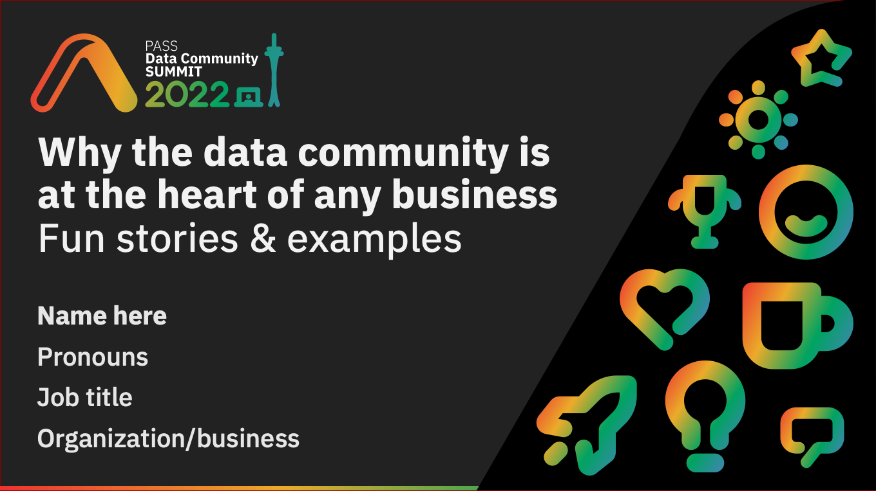
You can personalize your title slide using the icons provided on page 8, or you can simply use the default title slide. Examples:
Default title slide
Personalized
Personalized
Personalized
Please avoid overlapping the icons or the curve
Avoid distorting or rotating the icons
Have fun and use icons that relate to your session

Slide 6
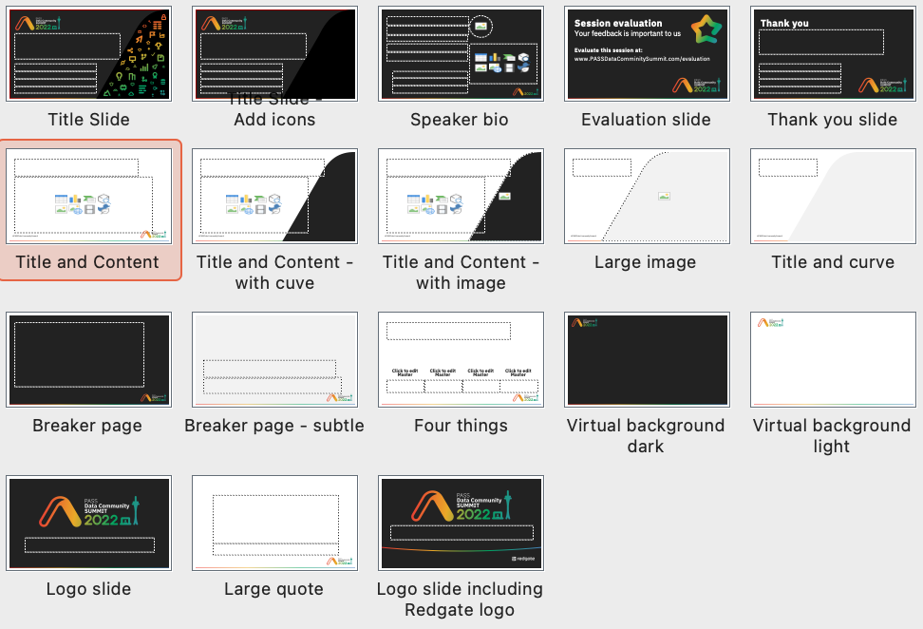
Other slide templates A variety of other slide layouts are provided

Slide 7
Icons and graphics You can use the provided icons and graphics throughout your presentation

Slide 8





























































Icons
A selection of icons for use in your presentations

Slide 9
Using the icons
The icons can be used big or small.
Please avoid overlapping or distorting the icons.
They can be used as bullet points
Just like they’re being used here
Keep them relevant to the point if possible

Slide 10






Other graphics you may find useful

Slide 11

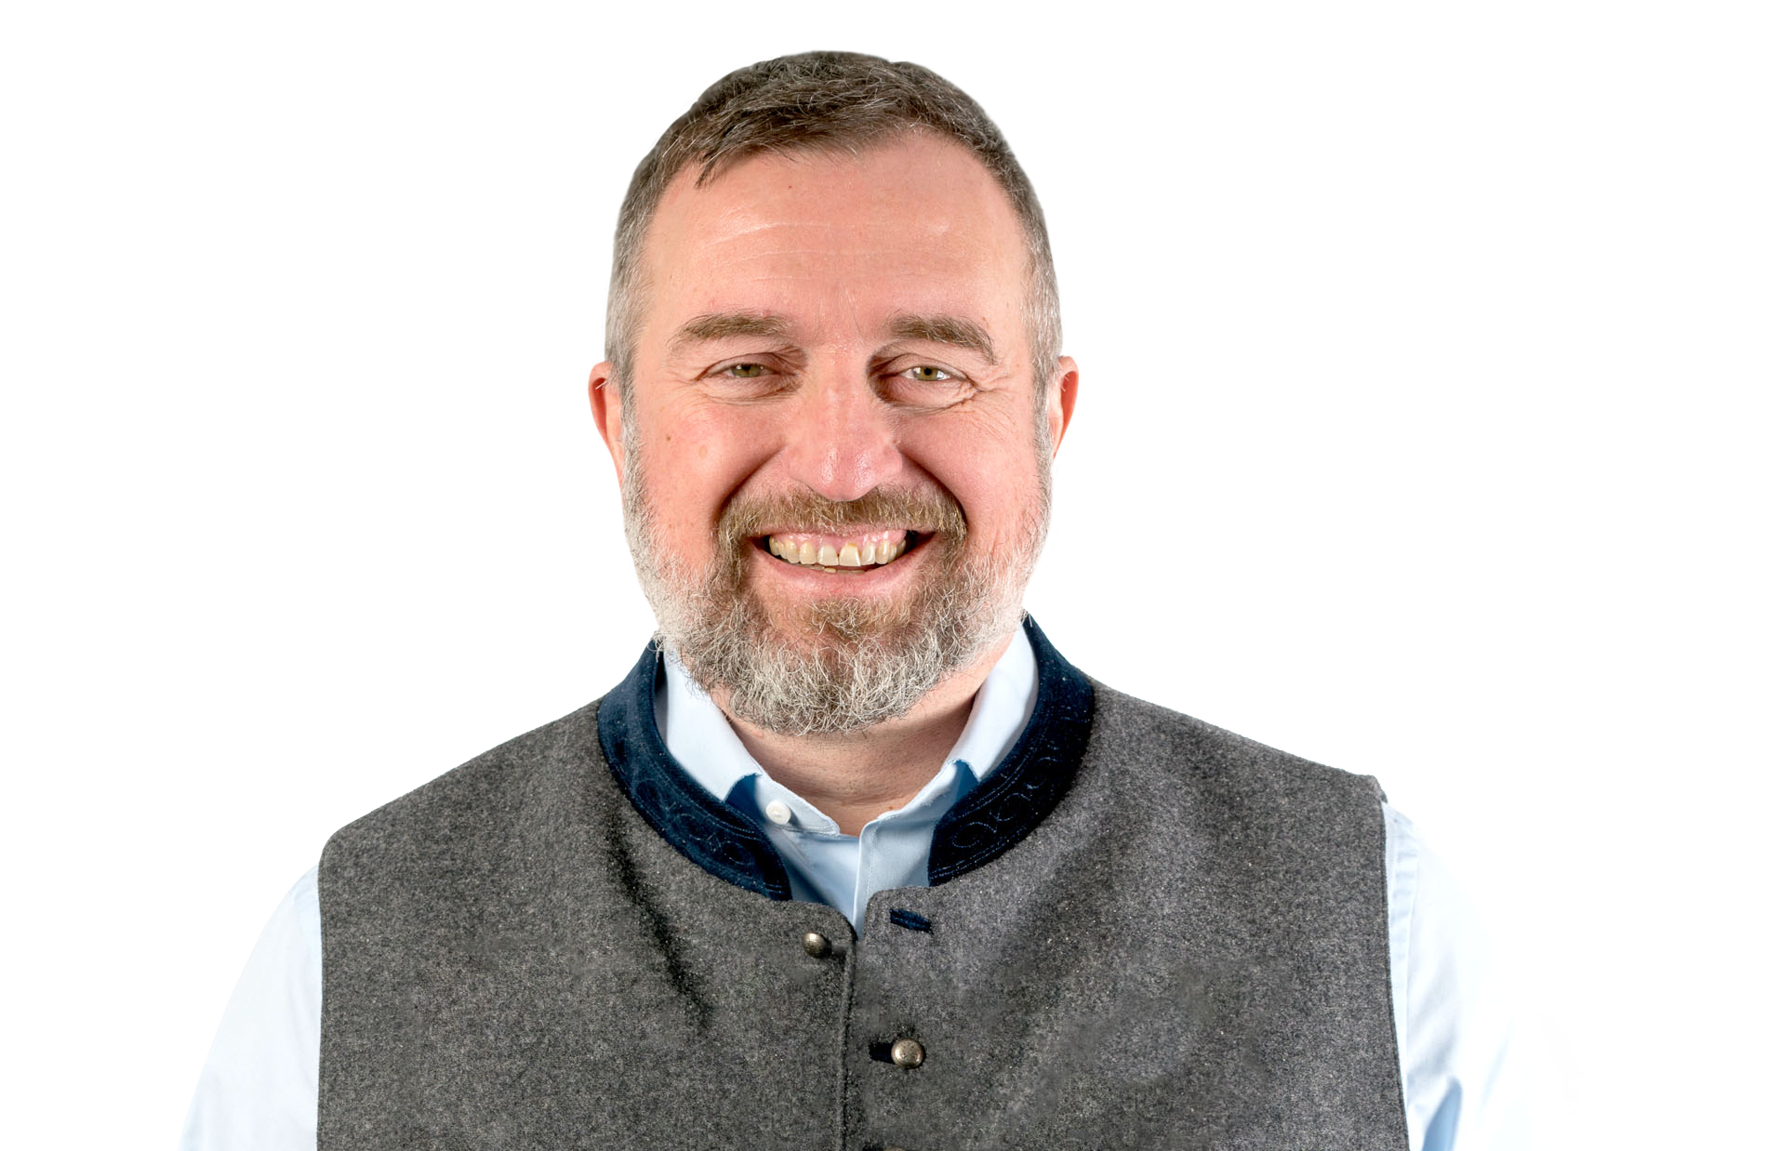
Virtual backgrounds (optional) Create your own, and why not match it to your title slide

Slide 12







Virtual background examples

Slide 13
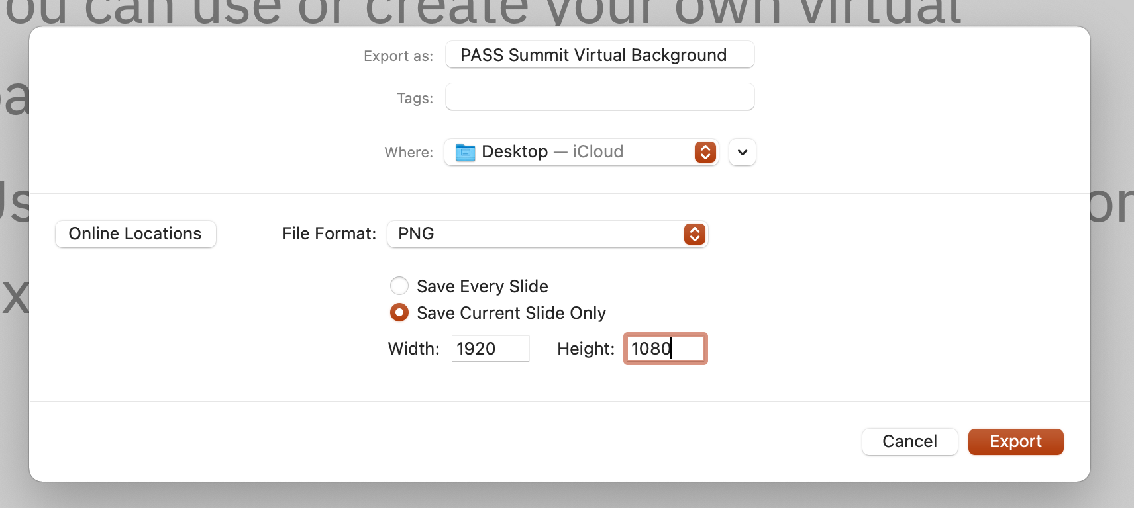
Create your own virtual background
Use the Virtual background slide layout
Add the icons from page 8
Avoid overlapping or distorting the icons
Export the slide as a png

Slide 14
Slide examples

Slide 15
This is the default title slide Using the default icons
Name here
Pronouns
Job title
Organization/business

Slide 16
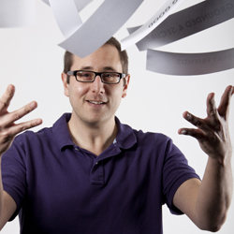
Peter
Woodhouse
He/Him
Designer
Ive worked for agencies, for my own clients and as a freelancer. For large organisations and small family businesses, from designing websites for the NHS to branding local restaurants. Currently i'm working at Redgate, a software company in Cambridge, UK.
Redgate Software
@petewoodhouse
Petewoodhouse.medium.com
www.pete.co

Slide 17
Message for the end of the presentation goes here
Name goes here
Contact or social
Contact or social
Contact or social

Slide 19
Why encryption isn’t enough for database development environments
Name goes here
Pronouns
Job title
Organization/business

Slide 20
Why encryption isn’t enough for database development environments
Name goes here
Pronouns
Job title
Organization/business

Slide 21
Why is Database DevOps essential for cloud migration
Name here
Pronouns
Job title
Organization/business

Slide 22
Github basics for any DBA Practical tips
Name here
Pronouns
Job title
Organization/business

Slide 23
Why the data community is at the heart of any business Fun stories & examples
Name here
Pronouns
Job title
Organization/business

